Slide 1

Data Analysis With Apache Flink
Aljoscha Krettek / Till Rohrmann
Flink committers
Co-founders @ data Artisans
aljoscha@apache.org / trohrmann@apache.org

Slide 2
What is Apache Flink?
Functional API
Relational API
Graph API
Machine Learning
…
Iterative Dataflow Engine
Notes:
Engine is Batch or Streaming

Slide 3
Apache Flink Stack
Gelly
Flink ML
Python
Table
Dataflow
Table
SAMOA
Dataflow
Hadoop M/R
DataSet (Java/Scala)
DataStream (Java/Scala)
Batch Optimizer
Stream Builder
Distributed Runtime
Local
Remote
Yarn
Tez
Embedded
*current Flink master + few PRs

Slide 4
Example Use Case: Log Analysis

Slide 5
What Seems to be the Problem?
Collect clicks from a webserver log
Find interesting URLs
Combine with user data
Web server log
Extract Clicks
user
data base
Combine
Massage
Interesting
User Data

Slide 6
The Execution Environment
Entry point for all Flink programs
Creates DataSets from data sources
ExecutionEnvironment env =
ExecutionEnvironment.getExecutionEnvironment();
Notes:
Works also with Scala API

Slide 7
Getting at Those Clicks
post /foo/bar… 313
get /data/pic.jpg 128
post /bar/baz… 128
post /hello/there… 42
DataSet<String> log = env.readTextFile("hdfs:///log");
DataSet<Tuple2<String, Integer>> clicks = log.flatMap(
(String line, Collector<Tuple2<String, Integer>> out) ->
String[] parts = in.split("*magic regex*");
if (isClick(parts)) {
out.collect(new Tuple2<>(parts[1],Integer.parseInt(parts[2])));
} }
)

Slide 8
The Table Environment
Environment for dealing with Tables
Converts between DataSet and Table
TableEnvironment tableEnv = new TableEnvironment();

Slide 9
Counting those Clicks
Table clicksTable = tableEnv.toTable(clicks, "url, userId");
Table urlClickCounts = clicksTable
.groupBy("url, userId")
.select("url, userId, url.count as count");

Slide 10
Getting the User Information
Table userInfo = tableEnv.toTable(…, "name, id, …");
Table resultTable = urlClickCounts.join(userInfo)
.where("userId = id && count > 10")
.select("url, count, name, …");

Slide 11
The Final Step
class Result {
public String url;
public int count;
public String name;
…
}
DataSet<Result> set =
tableEnv.toSet(resultTable, Result.class);
DataSet<Result> result =
set.groupBy("url").reduceGroup(new ComplexOperation());
result.writeAsText("hdfs:///result");
env.execute();

Slide 12
What happens under the hood?

Slide 13
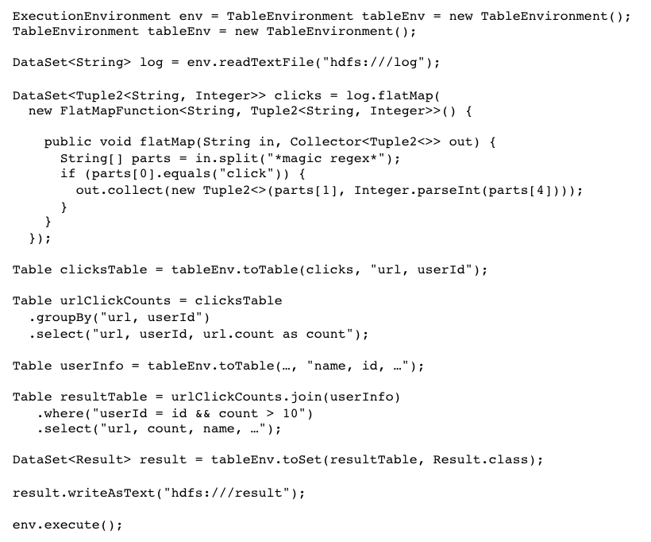
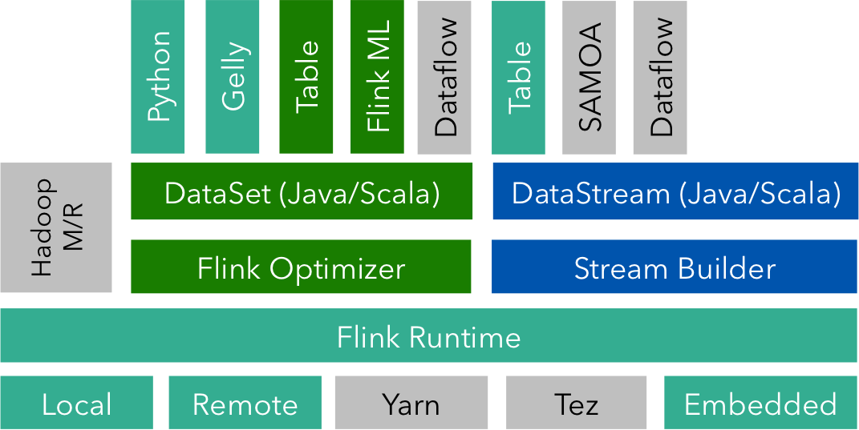
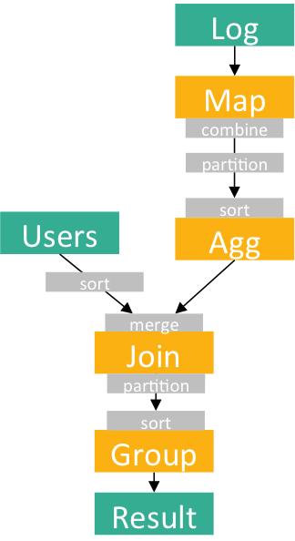
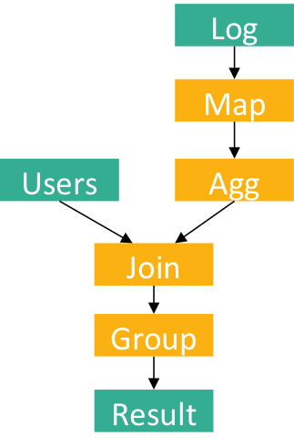
From Program to Dataflow
Flink Program
Optimized Plan
Dataflow Plan
Notes:
Visualization of program to plan to optimized plan to JobGraph
What you see is not what you get.

Slide 14

Distributed Execution
Master
Recovery
Orchestration
Worker
Serialization
Memory Management
Streaming
Network
Notes:
Pipelined Execution

Slide 15
Advanced Analysis: Website Recommendation

Slide 16
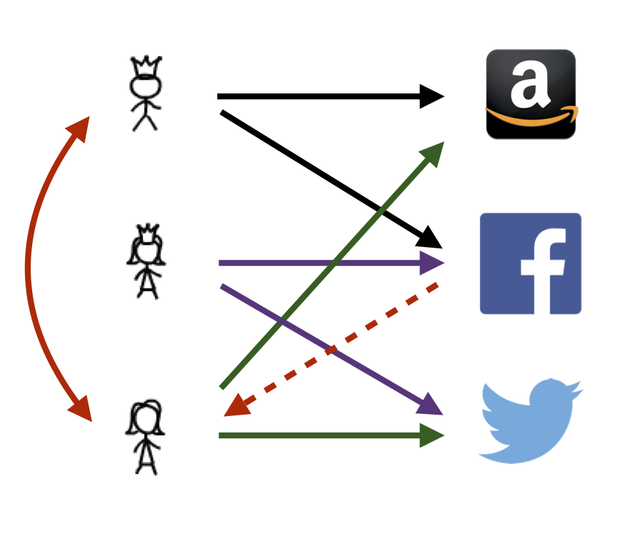
Going Further
Log analysis result: Which user visited how often which web site
Which other websites might they like?
Recommendation by collaborative filtering

Slide 17
Collaborative Filtering
Recommend items based on users with similar preferences
Latent factor models capture underlying characteristics of items and preferences of user
Predicted preference:

Slide 18
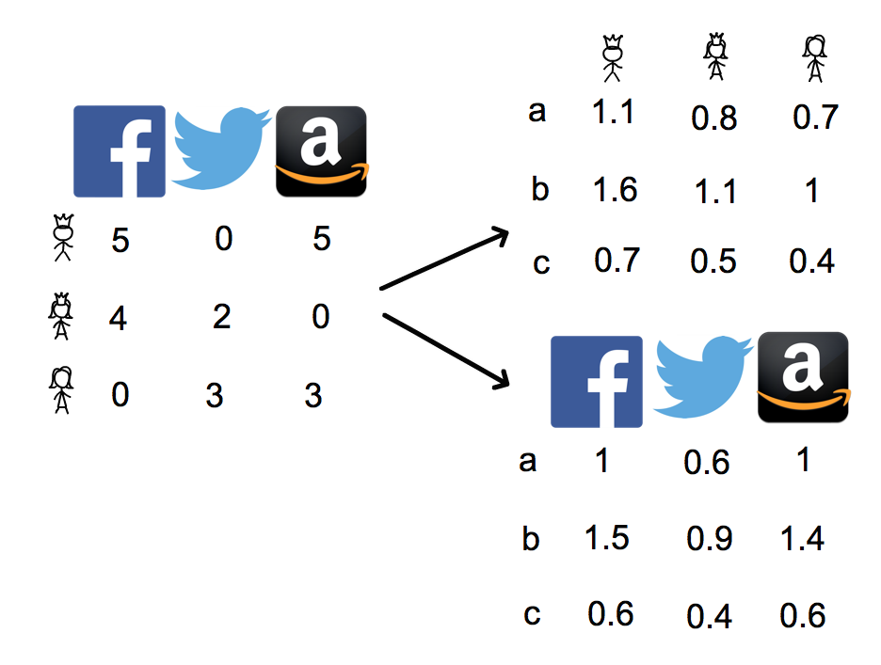
Matrix Factorization

Slide 19
Alternating least squares
Iterative approximation
Fix X and optimize Y
Fix Y and optimize X
Communication and computation intensive
X
Y
R
x
=
X
Y
R
x
=

Slide 20

Matrix Factorization Pipeline
Clickstream Data
Hashing Feature Extractor
ALS
Matrix factorization
val featureExtractor = HashingFT() val factorizer = ALS() val pipeline = featureExtractor.chain(factorizer) val clickstreamDS =
env.readCsvFile[(String, String, Int)](clickStreamData)
val parameters = ParameterMap() .add(HashingFT.NumFeatures, 1000000) .add(ALS.Iterations, 10) .add(ALS.NumFactors, 50)
.add(ALS.Lambda, 1.5) val factorization = pipeline.fit(clickstreamDS, parameters)

Slide 21
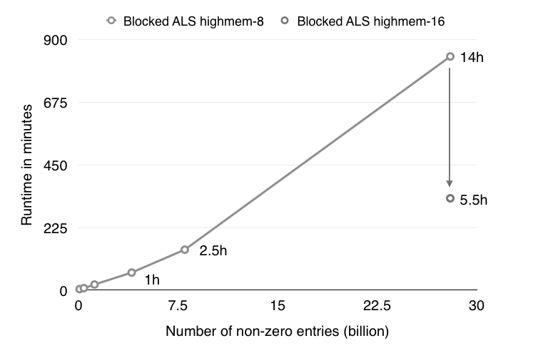

Does it Scale?
Scale of Netflix or Spotify
40 node GCE cluster, highmem-8
10 ALS iteration with 50 latent factors
Based on Spark MLlib’s implementation

Slide 22
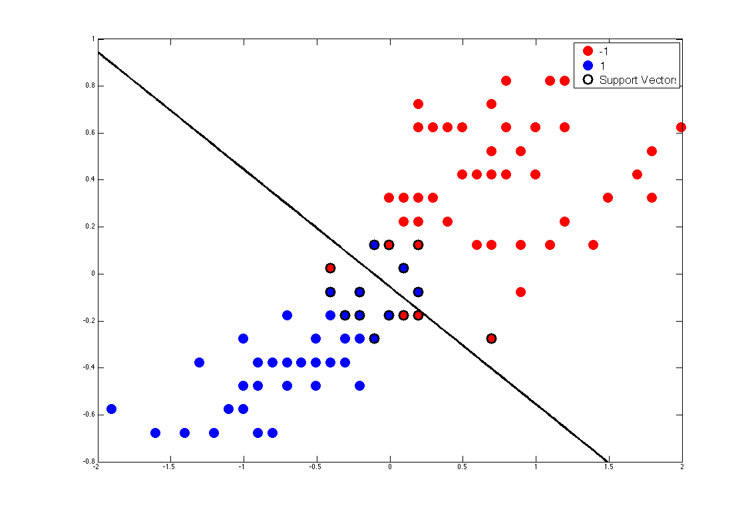
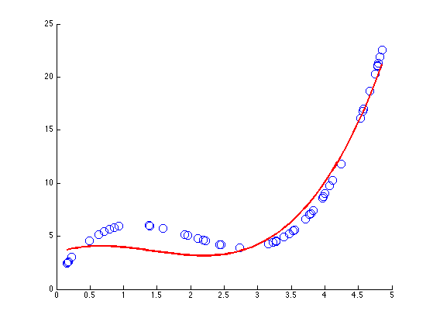
What Else Can You Do?
Classification using SVMs
Conversion goal prediction
Clustering
Visitor segmentation
Multiple linear regression
Visitor prediction

Slide 23
Closing

Slide 24
What Have You Seen?
Flink is a general-purpose analytics system
Highly expressive Table API
Advanced analysis with Flink’s machine learning library
Jobs are executed on powerful distributed dataflow engine

Slide 25
Flink Roadmap for 2015
Additions to Machine Learning library
Streaming Machine Learning
Support for interactive programs
Optimization for Table API queries
SQL on top of Table API
Notes:
Algorithms:
Decision trees and random forests
PCA
CCA
More transformers:
Scaler, Centering, Whitening
Feature extractor
Count vectorizer
Outlier detector
Support for cross validation
Improved pipeline support
Automatic pre- and post-processing pipeline
SAMOA support
Pending PR which will be merged with the upcoming milestone release
Integration with Zeppelin, a IPython Notebook-like web interface for explorative data analysis

Slide 26


Slide 27

flink.apache.org @ApacheFlink

Slide 28
Backup Slides

Slide 29
WordCount in DataSet API
case class Word (word: String, frequency: Int)
val env = ExecutionEnvironment.getExecutionEnvironment()
val lines = env.readTextFile(...)
lines
.flatMap {line => line.split(" ").map(word => Word(word,1))}
.groupBy("word").sum("frequency”)
.print()
env.execute()
Java and Scala APIs offer the same functionality.

Slide 30
Log Analysis Code
ExecutionEnvironment env = TableEnvironment tableEnv = new TableEnvironment();
TableEnvironment tableEnv = new TableEnvironment();
DataSet<String> log = env.readTextFile("hdfs:///log");
DataSet<Tuple2<String, Integer>> clicks = log.flatMap(
new FlatMapFunction<String, Tuple2<String, Integer>>() {
public void flatMap(String in, Collector<Tuple2<>> out) {
String[] parts = in.split("*magic regex*");
if (parts[0].equals("click")) {
out.collect(new Tuple2<>(parts[1], Integer.parseInt(parts[4])));
}
}
});
Table clicksTable = tableEnv.toTable(clicks, "url, userId");
Table urlClickCounts = clicksTable
.groupBy("url, userId")
.select("url, userId, url.count as count");
Table userInfo = tableEnv.toTable(…, "name, id, …");
Table resultTable = urlClickCounts.join(userInfo)
.where("userId = id && count > 10")
.select("url, count, name, …");
DataSet<Result> result = tableEnv.toSet(resultTable, Result.class);
result.writeAsText("hdfs:///result");
env.execute();

Slide 31
Log Analysis Dataflow Graph
Log
Log
Map
Map
combine
partition
Users
Agg
Users
sort
Agg
sort
Join
merge
Join
Group
partition
sort
Result
Group
Result

Slide 32


Pipelined Execution
Note: Intermediate DataSets are not necessarily “created”!
Only 1 Stage
(depending on join strategy)
Data transfer in-memory and disk if needed
Notes:
Visualization of JobGraph to ExecutionGraph

Slide 33
API in a Nutshell
Element-wise
map, flatMap, filter
Group-wise
groupBy, reduce, reduceGroup, combineGroup, mapPartition, aggregate, distinct
Binary
join, coGroup, union, cross
Iterations
iterate, iterateDelta
Physical re-organization
rebalance, partitionByHash, sortPartition
Streaming
window, windowMap, coMap, ...

